Slide 1


Danyil Yurtseniuk
16.03.2024

Slide 2

Outline
Executive Summary
Introduction
Methodology
Results
Conclusion
Appendix

Slide 3
Executive Summary
Summary of methodologies:
Data collection via API and Web Scraping
Exploratory Data Analysis with Data Visualization
Data Analysis with SQL
Interactive map with Folium
Dashboard
Predictive Analysis
Summary of all results:
1)EDA results
2)Interactive charts and maps
3)Predictive model

Slide 4
Introduction
Project background and context:
Predictive model which can predict whether first stage of Falcon 9 rocket will successfully land, is a possibility to save millions of dollars for SpaceX, and gather important intel for their competitors.
Problems you want to find answers
What is the relationships between such variables as Payload, Launch site, Orbit, and many more on the chances to land the rocket successfully
How can we plan our future launches in a way where successfully landing a rocket is more common.

Slide 5

Section 1

Slide 6
Methodology
Executive Summary
Data collection methodology:
SpaceX REST API
Wikipedia
Perform data wrangling
Standardizing and normalizing data
Perform exploratory data analysis (EDA) using visualization and SQL
Perform interactive visual analytics using Folium and Plotly Dash
Perform predictive analysis using classification models
How to build, tune, evaluate classification models

Slide 7
Data Collection
Describe how data sets were collected.
You need to present your data collection process use key phrases and flowcharts

Slide 8
Data Collection – SpaceX API
Most vital information was received with the help of API.
The URL is:
https://github.com/DreamDoct/Final-Assignment/blob/main/DataCollection_API.ipynb
API request
Return of a JSON
Utilizing data
API request

Slide 9
Data Collection - Scraping
The URL is:
https://github.com/Roderic19/IBM-Applied-Data-Science-Capstone/blob/main/DataCollection_Webscraping.ipynb
HTML request of Wikipedia
Parse with Beautiful Soup
Convert
To a df
Utilize data

Slide 10
Data Wrangling
Unnecessary Data was dropped
Data was Standardized, numerical values were assigned to categorical
A single dataframe with all valuable data was handcrafted

Slide 11
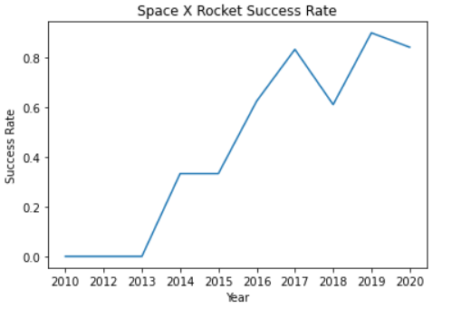
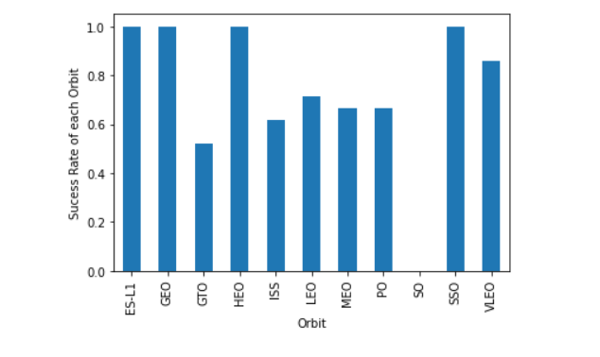
EDA with Data Visualization
URL: https://github.com/DreamDoct/Final-Assignment/blob/main/EDA_DataVisualization.ipynb

Slide 12
Predictive Analysis (Classification)
Steps include:
Standardization, normalization, splitting data
Model preparation
Model evaluation
Model comparison
Model deployment

Slide 13

Section 2

Slide 14
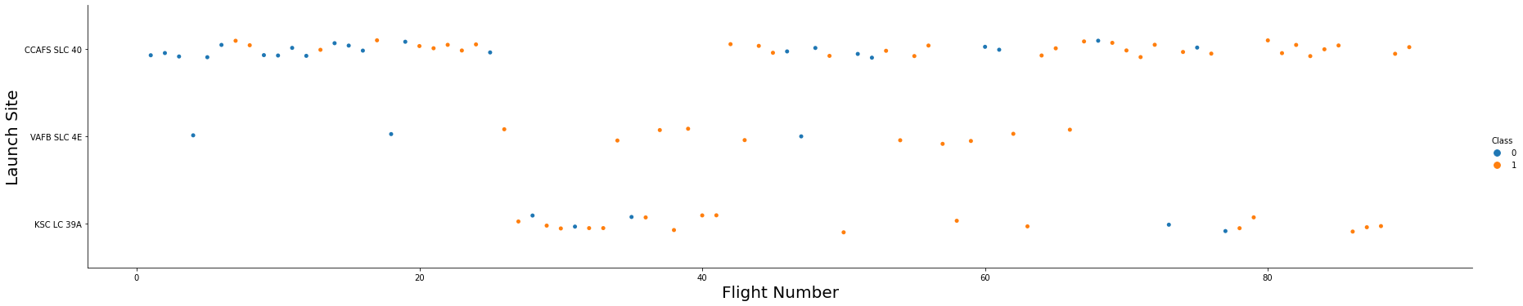
Flight Number vs. Launch Site
Success rate is clearly increasing!

Slide 15
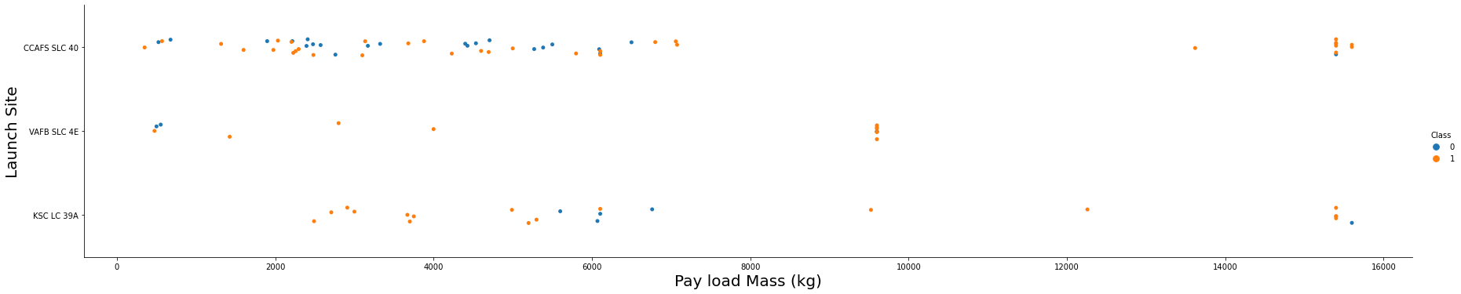
Payload vs. Launch Site
Depending on a payload, different launch sites may be chosen. Which will oftentimes influence the success rate.

Slide 16
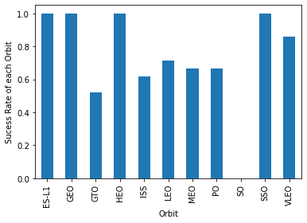
Success Rate vs. Orbit Type

Slide 17
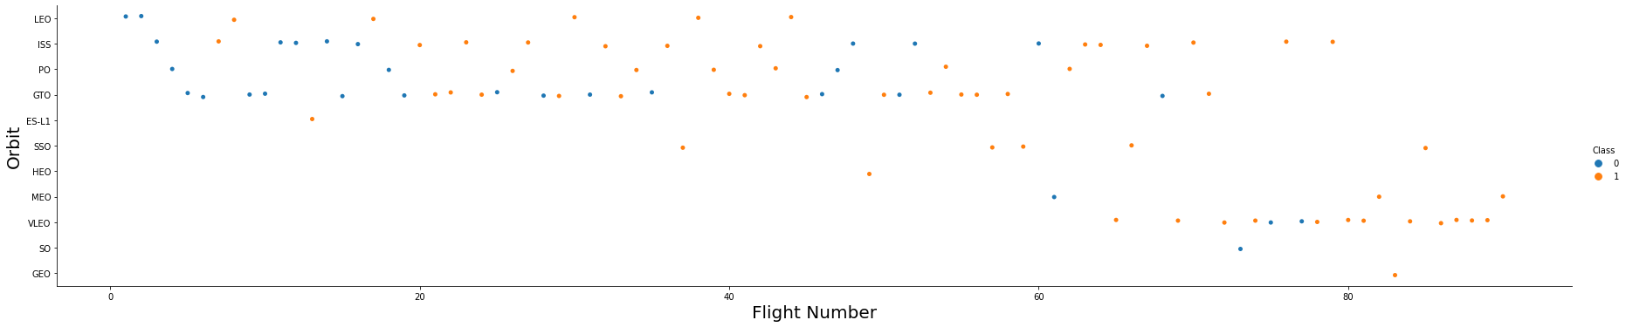
Flight Number vs. Orbit Type
Success rate increases, the more experienced SpaceX becomes

Slide 18
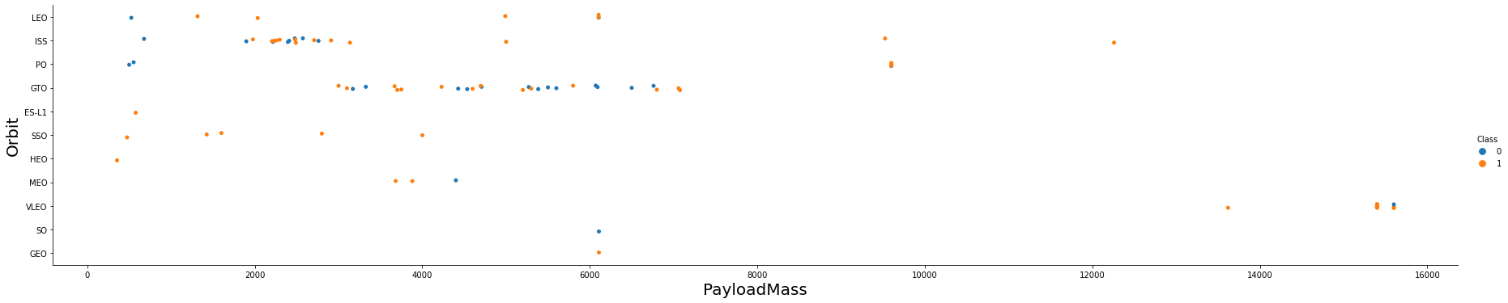
Payload vs. Orbit Type
Increasing a payload will lead to different results in different orbit types. GTO, for example, suffers the most from it.

Slide 19
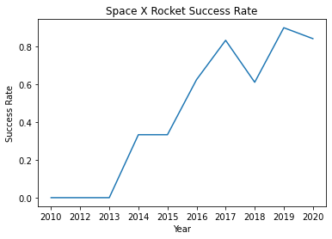
Launch Success Yearly Trend
2013 marked the start of SpaceX reusable stage 1 rockets, and their success rate was growing ever since

Slide 20
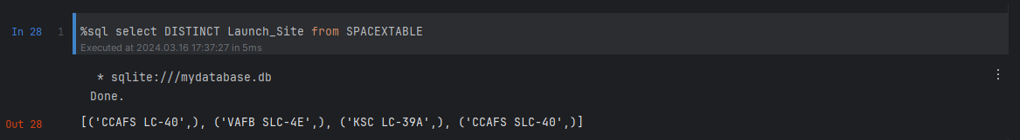
All Launch Site Names
Space X operated on various Launch Sites over the years

Slide 21
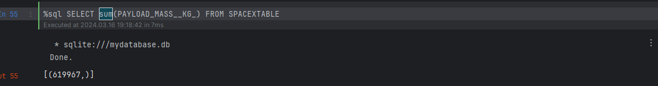
Total Payload Mass
The amount of weight, Space X delivered to the Earth orbit is comparable with 5 blue whales

Slide 22
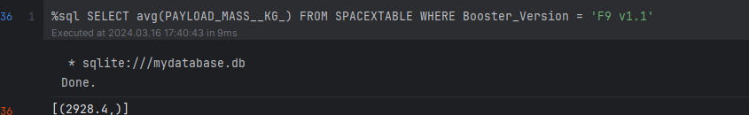
Average Payload Mass by F9 v1.1
Out of those 600 tons, average F9 v1.1 was delivering about 3 per launch

Slide 23
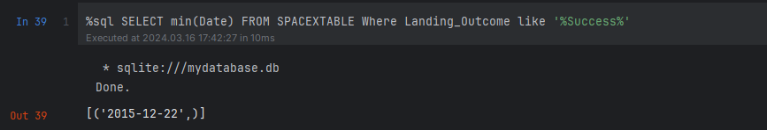
First Successful Ground Landing Date
First triumph happened on 2015/12/22

Slide 24
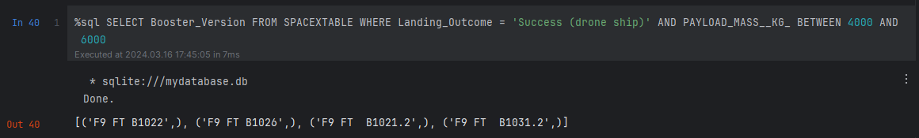
Successful Drone Ship Landing with Payload between 4000 and 6000
A couple of boosters were more resilient to weight

Slide 25
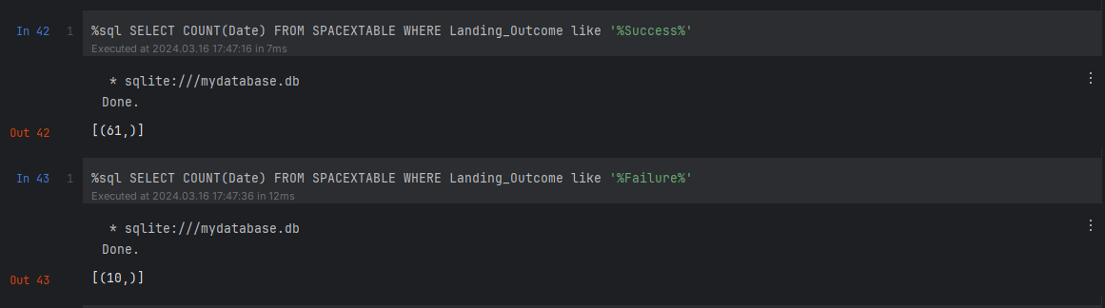
Total Number of Successful and Failure Mission Outcomes
Overall success rate is 85.9%

Slide 26
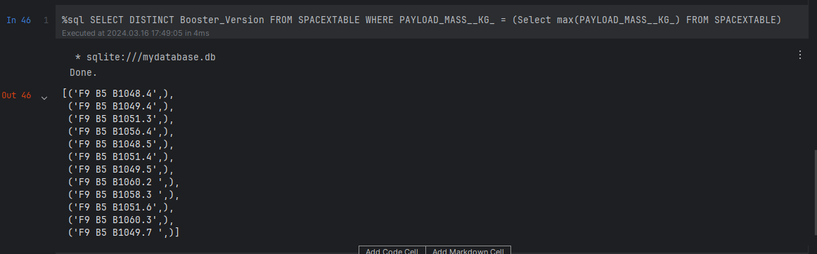
Boosters Carried Maximum Payload
F9 B5 carried the most payload per launch out of every booster

Slide 27
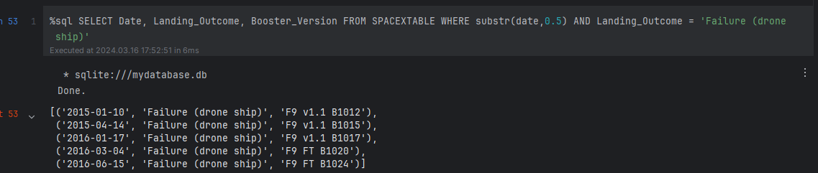
2015 Launch Records

Slide 28

Section 3

Slide 29
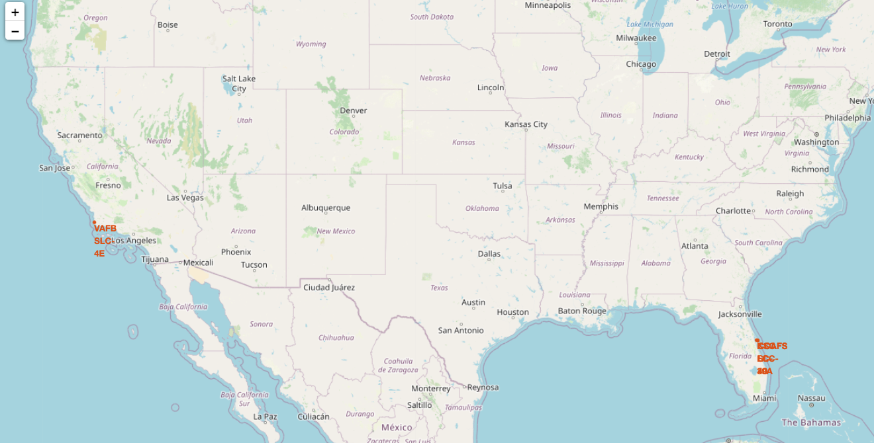
Locations of Launch Sites

Slide 30
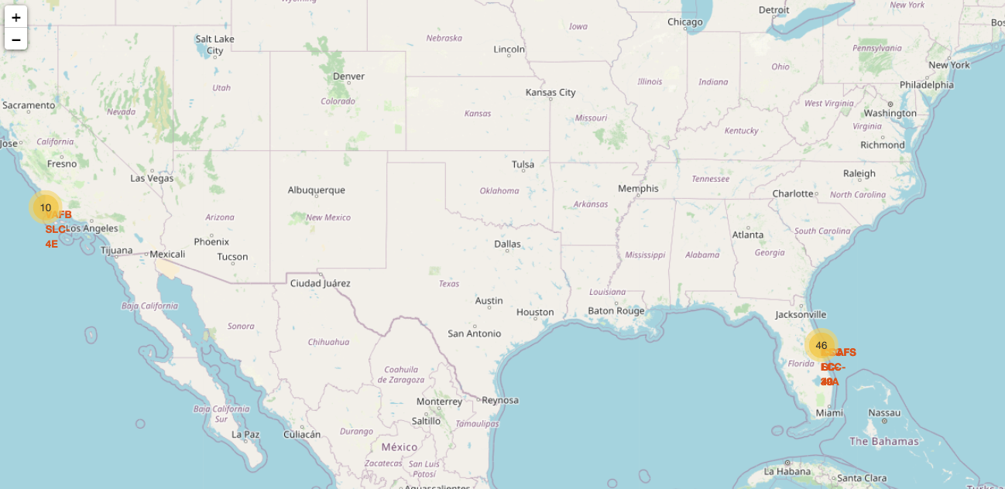
Heat map of success rates

Slide 31
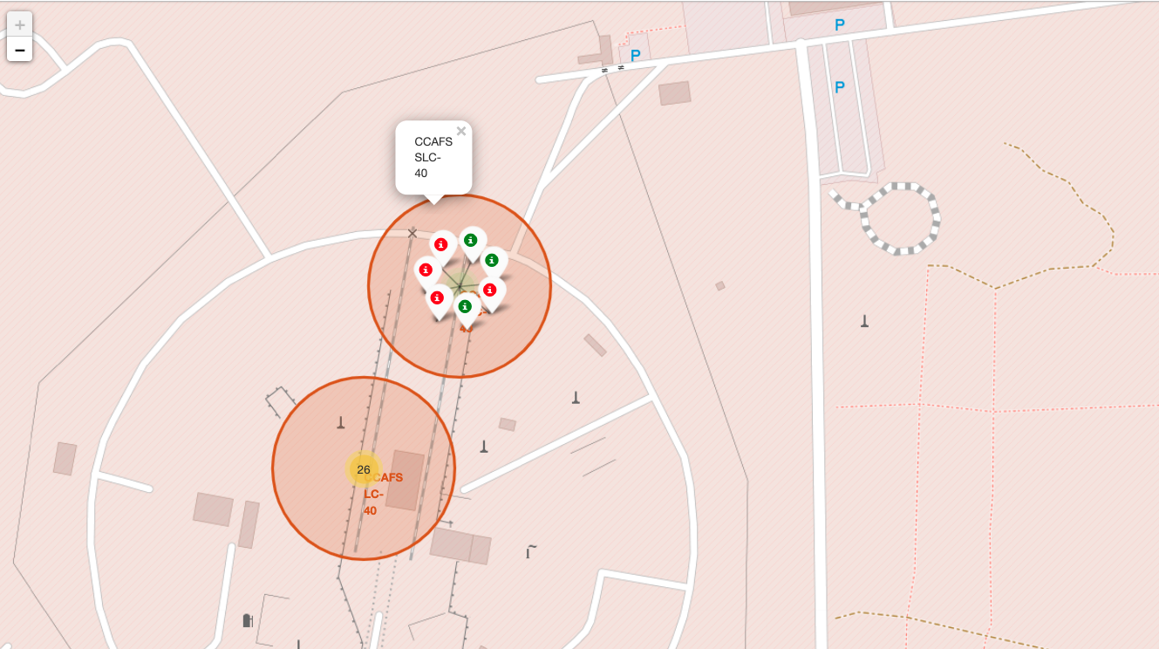

Slide 32

Section 4

Slide 33
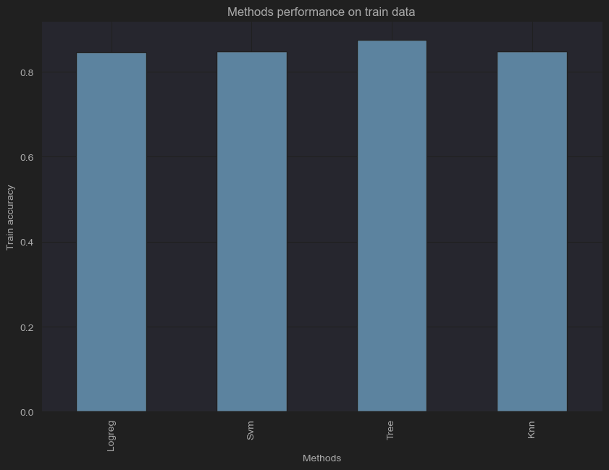
Classification Accuracy
Tree has highest accuracy

Slide 34
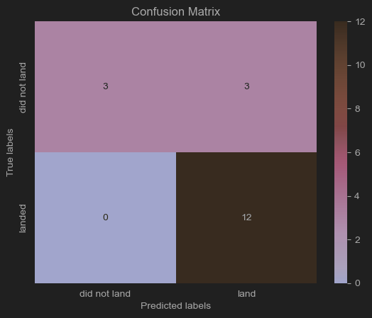
Confusion Matrix
Confusion matrix shows stunning accuracy with only 3 mistakes out of whole dataset

Slide 35
Conclusions
Time and data shows, that SpaceX is becoming better and better at safely landing booster stages.
Even further growth is expected
Tree model built and showcased earlier can predict accuracy of the outcome of landing with circa 80% accuracy
The most detrimental aspects that are influencing the outcome are: launch sites and date(weather)

Slide 36


